Slide 1
Rankings!

Slide 2


Slide 3
On the Litkenhous though...
Created in 1934
Lack transparency
Simply playing an inferior opponent harms a good team’s rating
Outdated

Slide 4
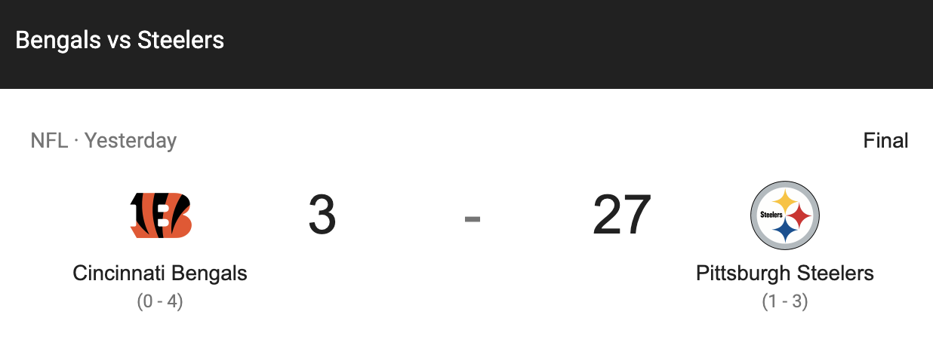

Slide 5
A philosophical look at our systems
Massey
Point Differential measures how good a team is
Colley
Only counts wins and losses
Elo
Creates a prediction for each game and rates teams based off of that projection

Slide 6
Massey
Uses a matrix for point differential for each game
Benefits
Ratings are measured by the point differential (with a cap)
We set to 36 for football
Game * Massey = PD
Massey = inv( Game^{T} * Game ) * Game^{T} * PD

Slide 7
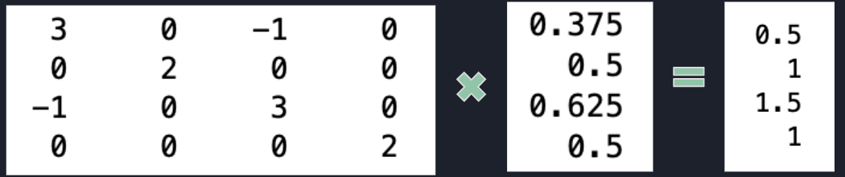
Colley
Begins ratings with modified winning percentage of 50%
Adjust based on record and quality of opposition that the teams face

Slide 8
Elo
Rating(new) = Rating(old) + K(Outcome - Predicted)
S = 220 K = 35 HFA = 11

